Slide 1




NEXT GEN EMPLOYABILITY PROGRAM
Creating a future-ready workforce
Team Members
College Name
Student Name : Jeshika S
Student ID : au960221104065
Arunachala College of Engineering For Women

Slide 2

CAPSTONE PROJECT SHOWCASE
Project Title
Car Rentals Application with Django Framework
Abstract | Problem Statement | Project Overview | Proposed Solution | Technology Used | Modelling & Results | Conclusion

Slide 3
Abstract
The growing demand for convenient transportation solutions has led to an increased reliance on car rental services worldwide. To address the evolving needs of both customers and rental service providers, this project introduces a comprehensive Car Rentals Application built on the Django web framework. The primary objective of this application is to streamline the process of car rentals by offering an intuitive, user-friendly platform for both customers and administrators. Customers can effortlessly browse through a diverse fleet of vehicles, check availability, make reservations, and manage their bookings conveniently. The system incorporates features such as real-time availability updates, flexible booking options, secure payment processing, and personalized user profiles to enhance the overall user experience.
Source :

Slide 4
Problem Statement
The aim of this project is to develop a comprehensive car rental application using the Django framework. The application should provide users with a convenient platform to browse, search, and book rental cars from a diverse fleet of vehicles. The system should offer features such as user authentication, car listings with detailed descriptions and photos, booking management, payment processing integration, and administrative tools for managing inventory, user accounts, and reservations. The goal is to create a seamless and user-friendly experience for both customers and administrators, enhancing efficiency and reliability in the car rental process.
Source :

Slide 5
Project Overview
The car rental application built on the Django framework aims to streamline the process of renting vehicles for customers and managing inventory for the rental agency. The platform offers a user-friendly interface where customers can browse available vehicles, check availability based on their desired dates and location, and make reservations seamlessly. It incorporates secure payment processing for booking confirmations. For the rental agency, the application provides robust inventory management features, allowing staff to add new vehicles, update availability, and track rental histories efficiently. Administrative tools enable easy monitoring of reservations, customer data management, and generating insightful reports for business analysis. Overall, the car rental application on Django offers a comprehensive solution for both customers and rental agencies, streamlining the rental process, improving efficiency, and enhancing the overall user experience.
Source :

Slide 6
Proposed Solution
.
Our proposed solution for a car rental application on the Django framework aims to streamline the rental process with user-friendly features.
Utilizing Django’s robust capabilities, we’ll develop a responsive platform allowing users to easily browse available cars, select rental dates, and make secure payments.
Incorporating advanced search filters and real-time availability updates, customers can quickly find the perfect vehicle for their needs.
The application will also include an intuitive dashboard for both users and administrators, enabling seamless management of bookings, inventory, and customer interactions.
With Django’s scalability and security features, our solution ensures a reliable and efficient car rental experience for all users.
Source :

Slide 7
The key components includes
• User Authentication: Secure user registration and login functionality to manage personal profiles and rental history. • Vehicle Listings: A comprehensive database of available vehicles with detailed descriptions, images, and pricing options. Users can filter by various criteria such as make, model, and rental duration. • Booking System: An intuitive booking interface where users can select their desired vehicle, rental dates, and additional services. Integration with payment gateways for secure transactions.
Source :

Slide 8
• Admin Dashboard: A centralized dashboard for administrators to manage vehicle inventory, user accounts, reservations, and rental policies. • Reservation Management: Users can view and modify their reservations, including cancellation and extension options. • Feedback and Reviews: Allow users to leave feedback and ratings for their rental experience, fostering transparency and improving service quality. Overall, the Django-based car rental application will streamline the rental process, enhance user satisfaction, and provide a robust platform for business management.
Source :

Slide 9


Technology Used
Front-end
Back-end
Source :

Slide 10
Modelling & Results
In developing a car rental application on the Django framework, a comprehensive model structure is essential for managing the various entities involved. Key models would include ‘Car’ to store information such as make, model, year, and availability status. ‘User’ model would handle user authentication and profile management Implementing robust views and controllers would facilitate smooth interaction between users and the application. Views would handle user requests, such as searching for available cars, making reservations, and managing rental history. Upon implementation, thorough testing and validation of the application’s functionality are imperative. This involves testing various user scenarios, including renting, returning, and canceling reservations, to ensure seamless operation and error handling. Finally, monitoring and analyzing application performance and user feedback are crucial for continual improvement and optimization of the car rental platform on the Django framework.
Source :

Slide 11
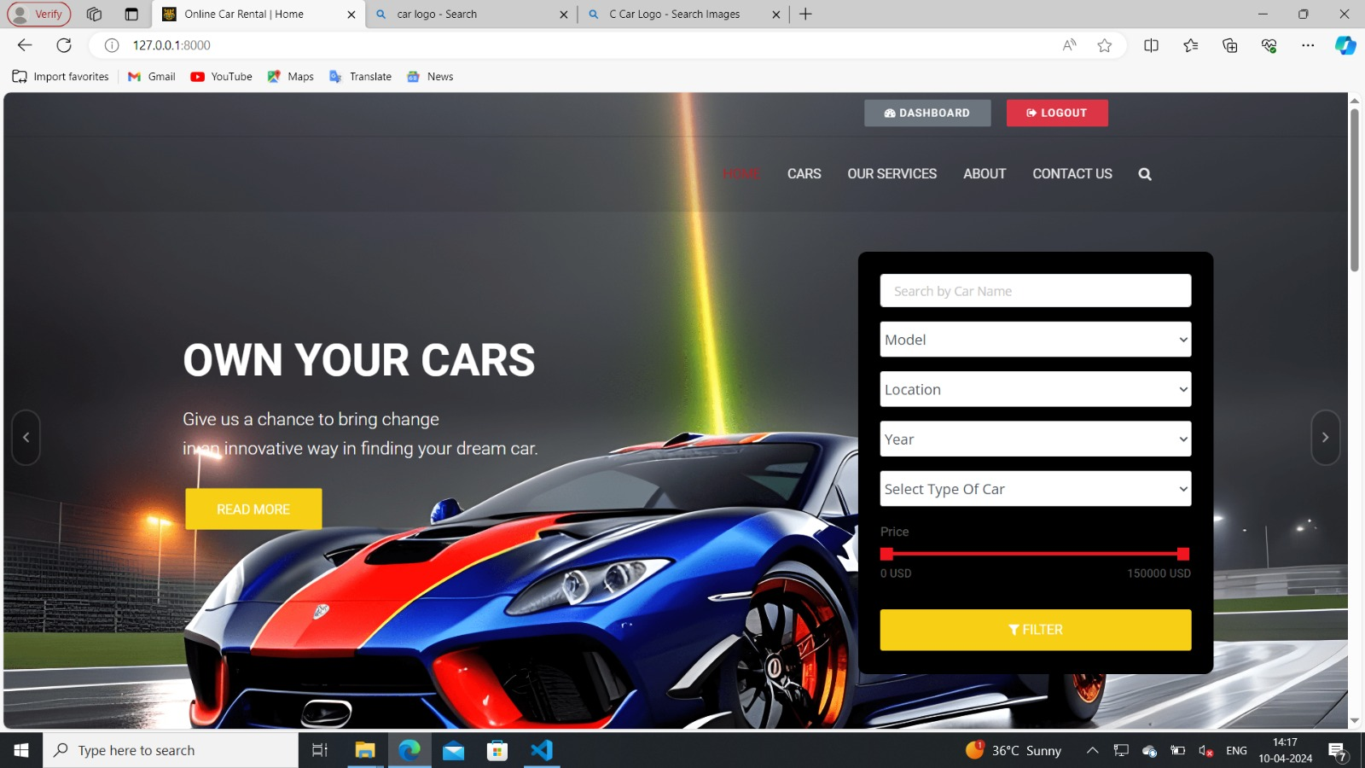
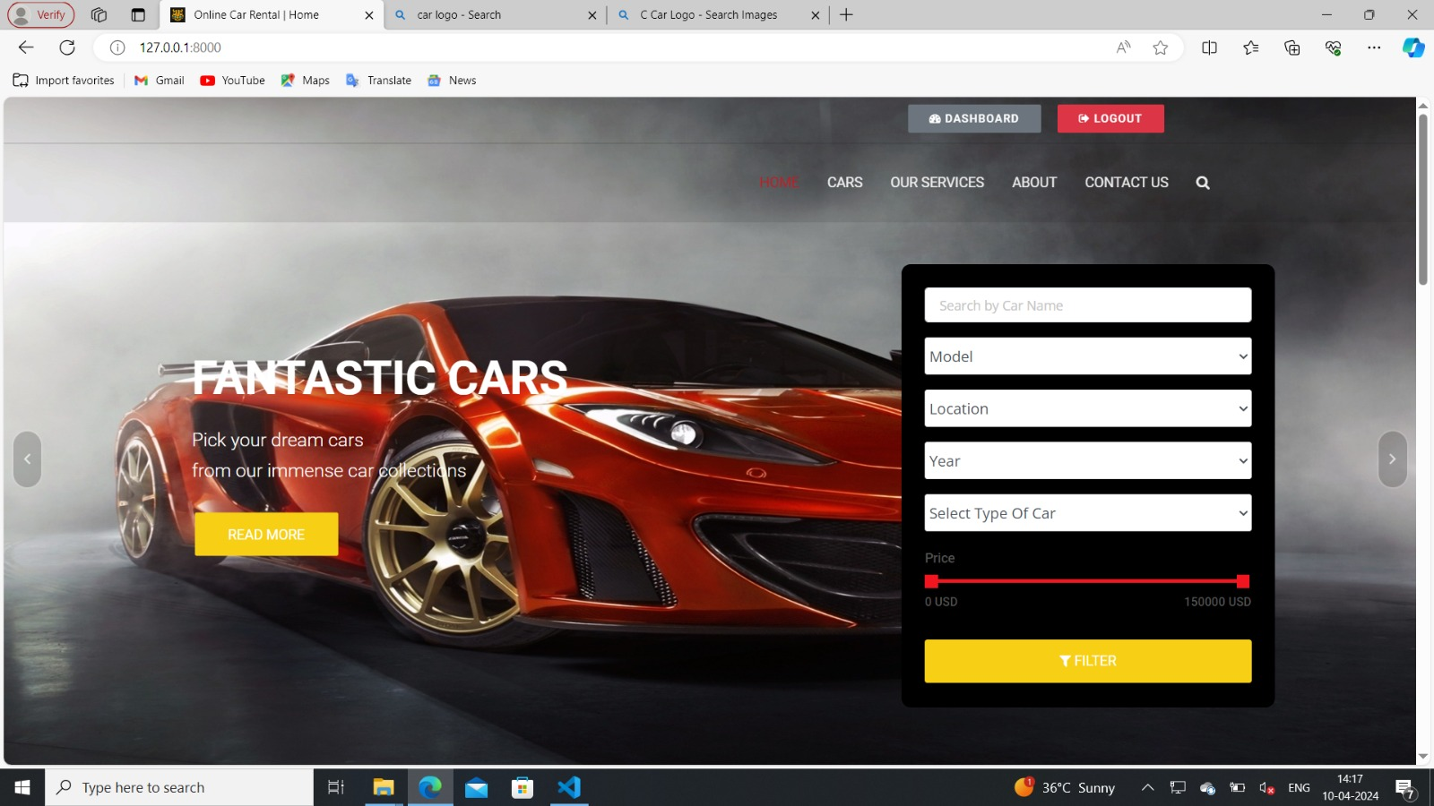
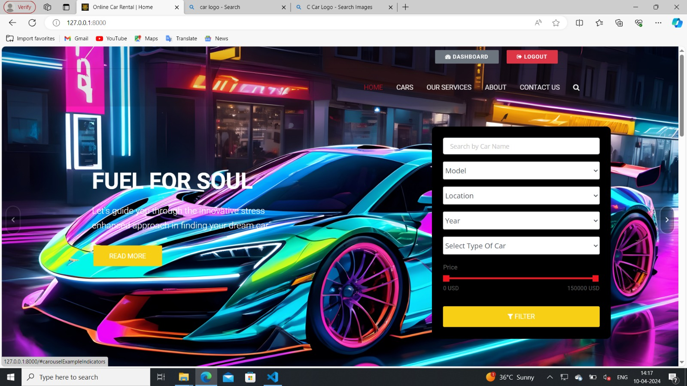
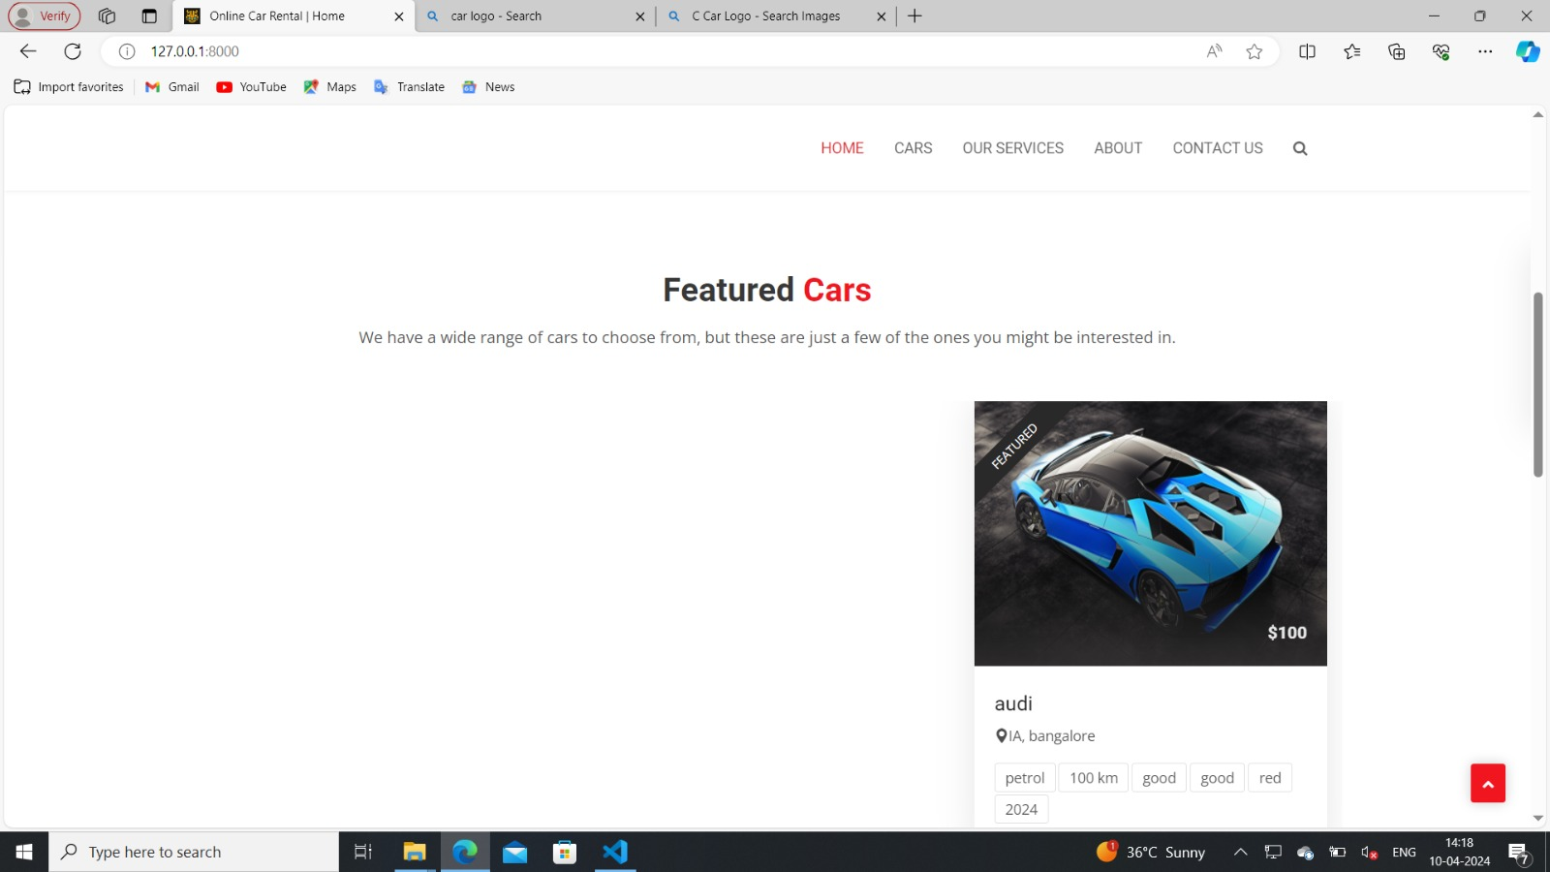
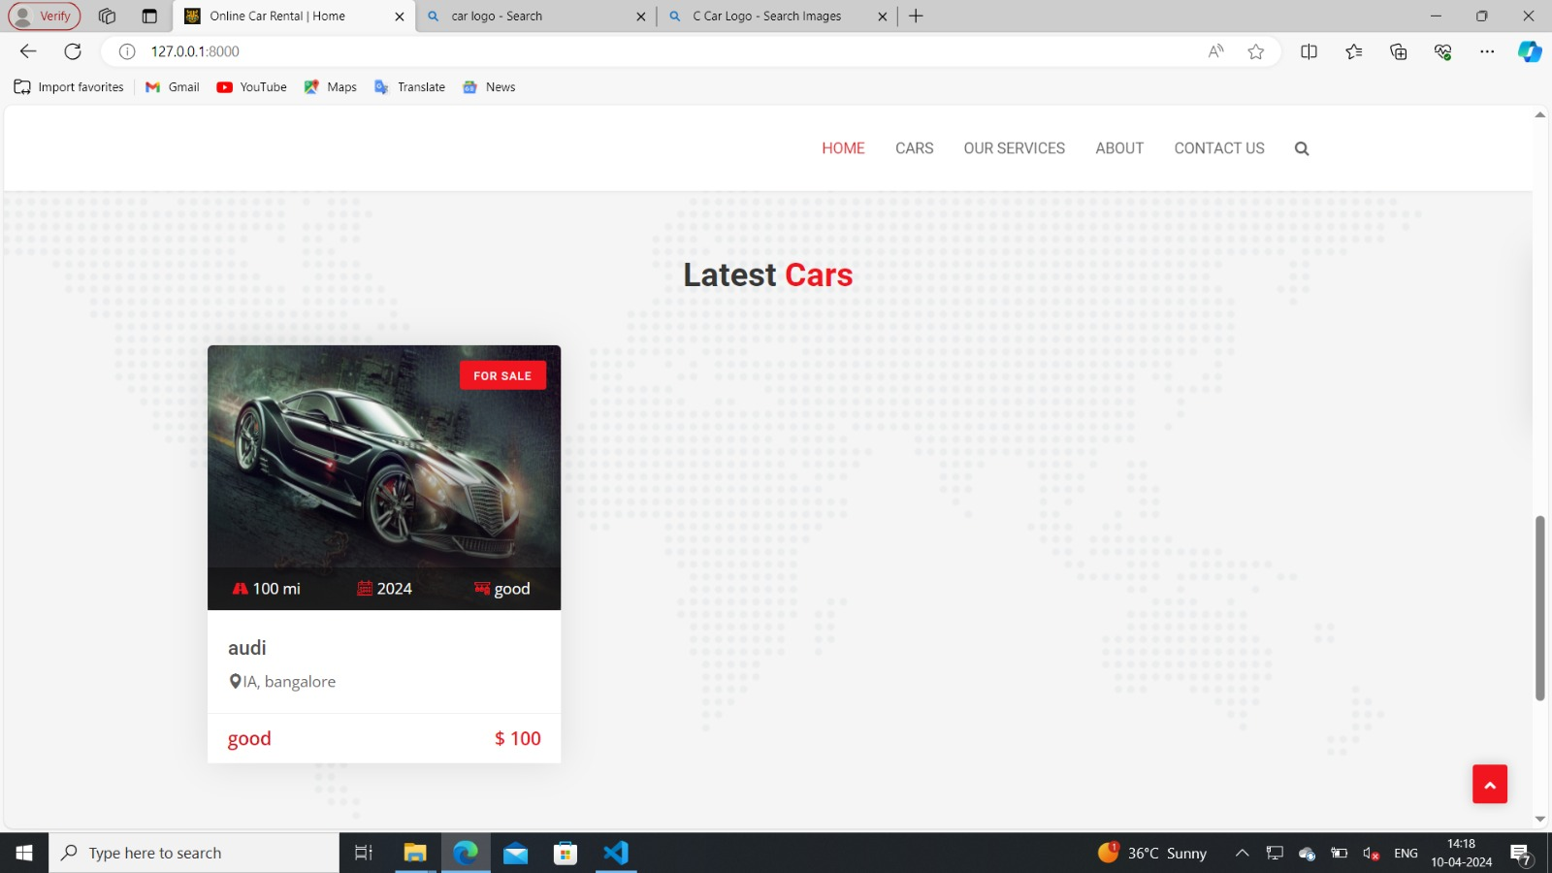
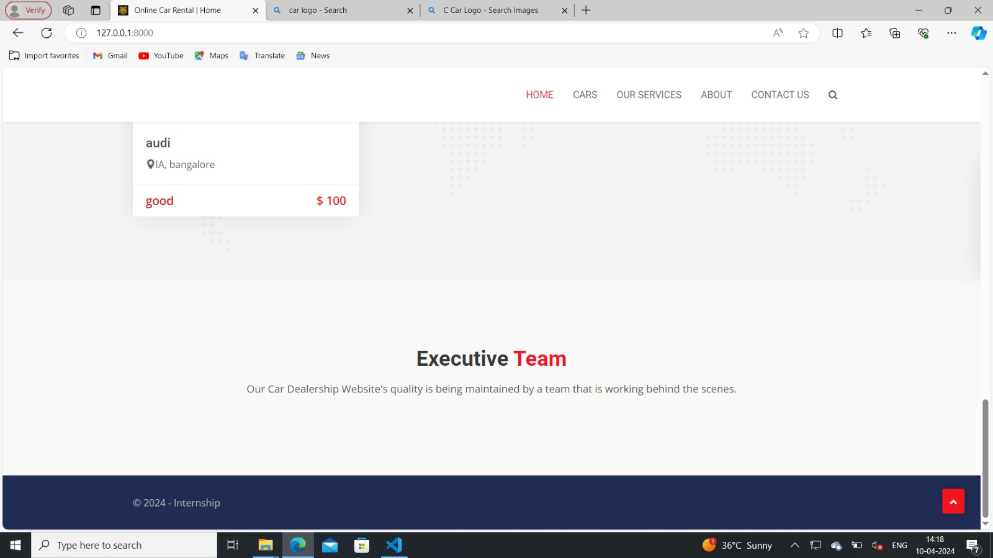
Homepage

Slide 12
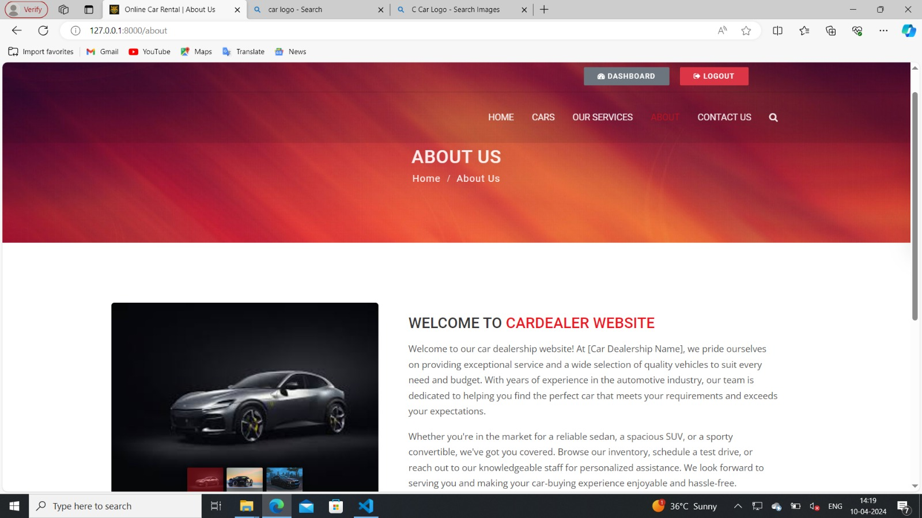
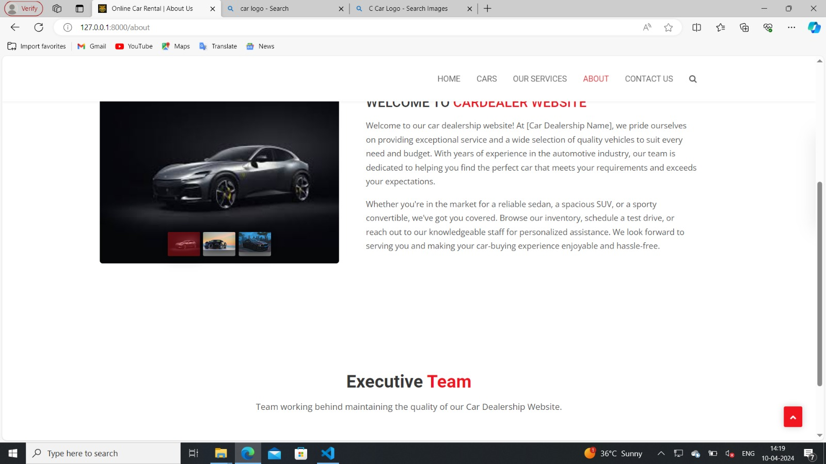
About-Us-Page

Slide 13
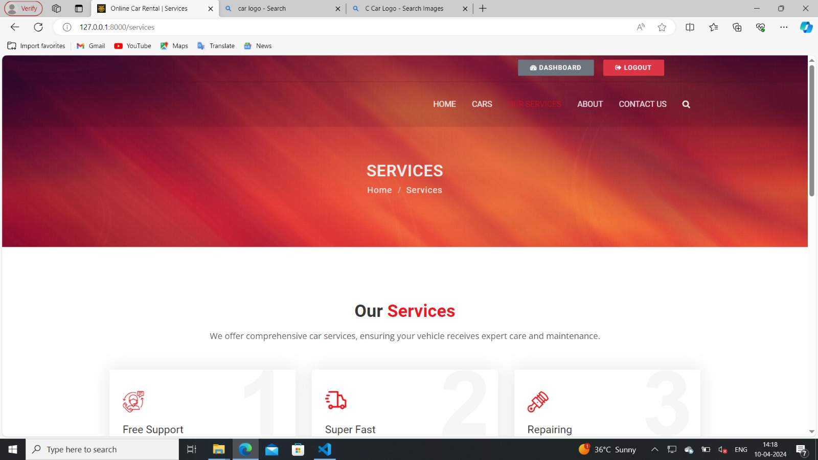
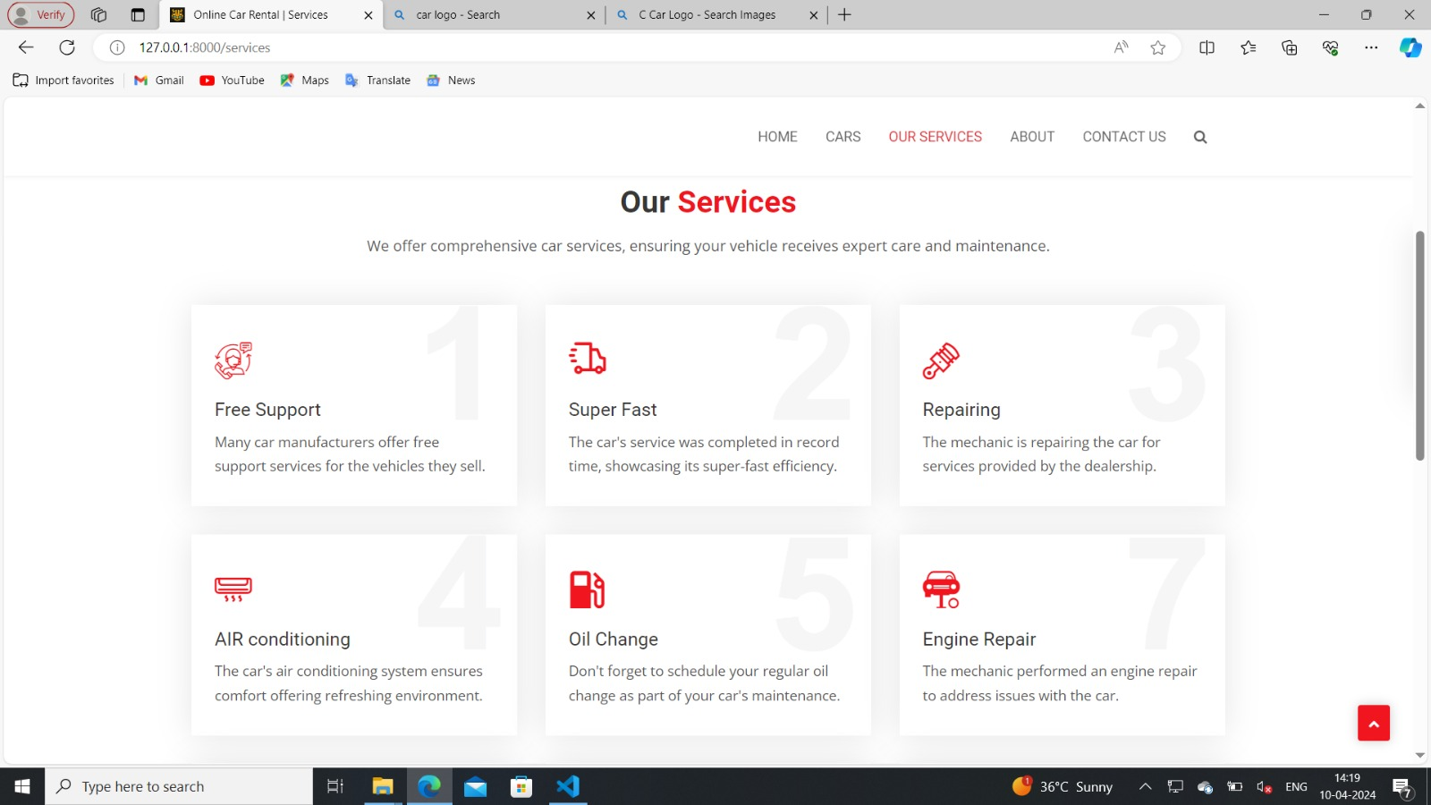
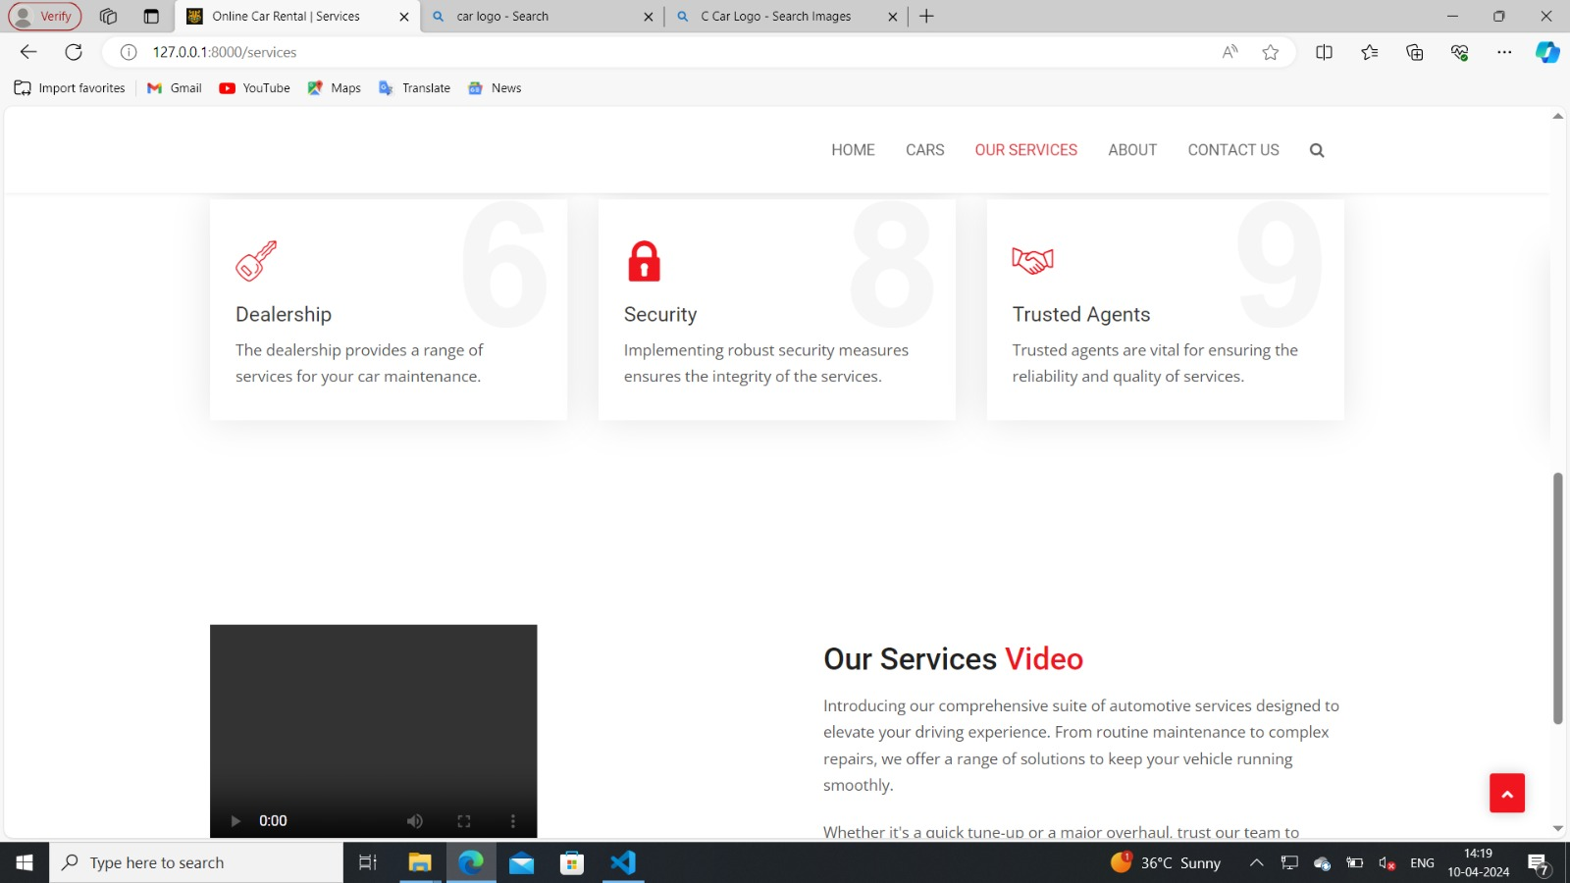
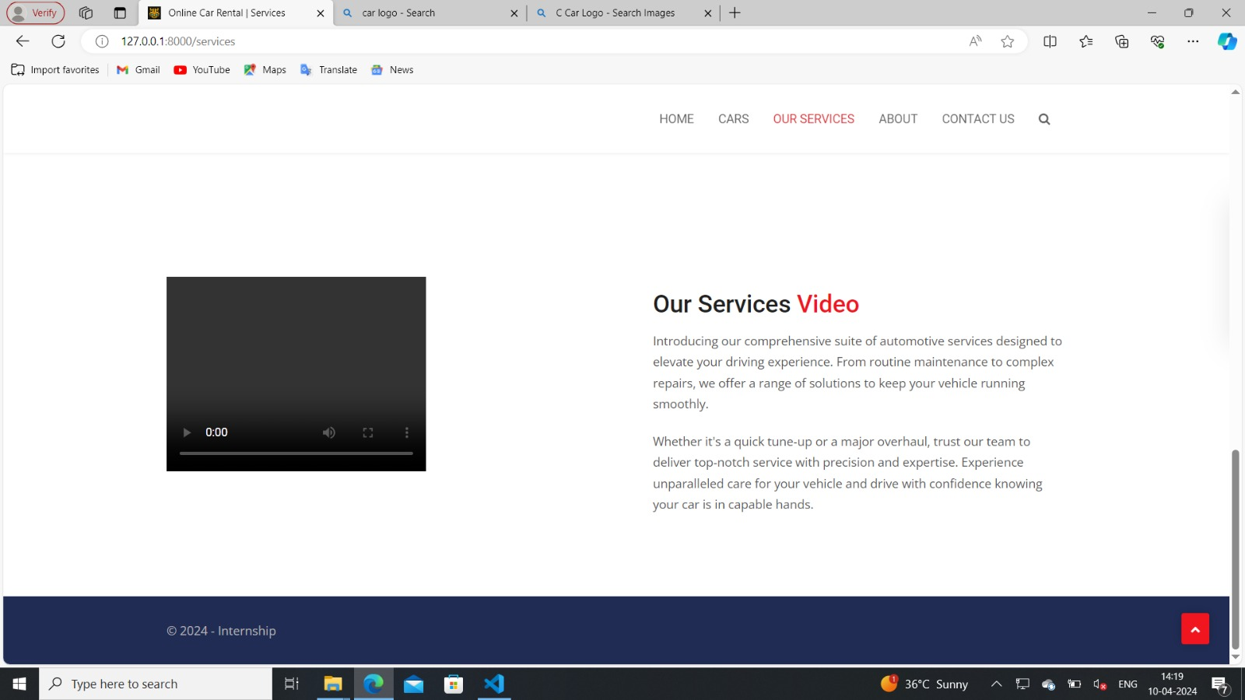
Service-Page

Slide 14
Future Enhancements:
• Enhance the search functionality to allow users to filter cars by criteria such as make, model, price range, and availability dates. • Integrate payment gateways to enable secure online payments for reservations and rentals. • Implement email or SMS notifications to keep users informed about booking confirmations, reminders, and updates on their rentals. • Implement a recommendation system based on user preferences and rental history to suggest suitable cars for their next booking.

Slide 15
Conclusion
• In conclusion, developing a car rental application with Django framework offers a robust and efficient solution for managing rental operations.
• Leveraging Django’s built-in features like ORM, authentication, and admin interface streamlines development and enhances security.
• By implementing features such as user authentication, booking management, and payment processing, the application provides a seamless experience for both customers and administrators.
• With Django’s scalability and extensibility, future enhancements and customization can be easily integrated to meet evolving business needs.
• Overall, the Django framework empowers developers to create a reliable and user-friendly car rental application that ensures a smooth rental experience for all stakeholders.Source :
Source :

Slide 16
Thank You!
Notes:
Thank You !!

